Slide 1
Frontend (React)
17356 S21
JJ, Sean

Slide 2
Concept: Frontend
What the user sees + interacts with.
“Client-side code”
Probably know of HTML/CSS/JS. You can build vanilla frontends.
We will learn React (https://reactjs.org)

Slide 3
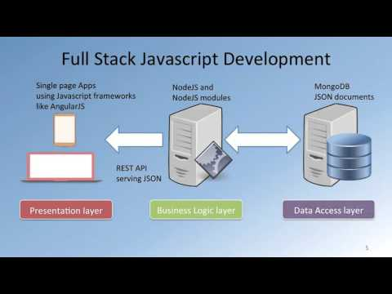
Visual
https://external-content.duckduckgo.com/iu/?u=https%3A%2F%2Fi.ytimg.com%2Fvi%2F6Z7OF86vB-M%2Fhqdefault.jpg&f=1&nofb=1

Slide 4
Interruption: Styling and CSS
We don’t have a dedicated recitation for styling, because there are so many many systems you can follow.
Google is your friend.
My personal pick: Flexbox
https://developer.mozilla.org/en-US/docs/Learn/CSS/CSS_layout/Flexbox
https://www.youtube.com/watch?v=JJSoEo8JSnc

Slide 5
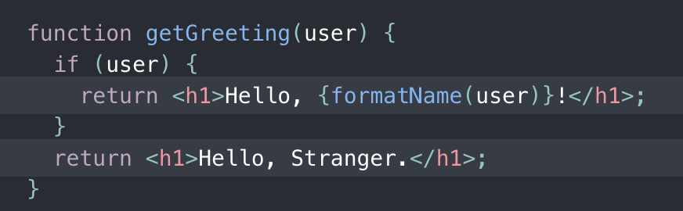
Intro to ReactJS (or just React)
Created 2011 (by Facebook)
“Frontend JS Library” (technically not a framework, but its chill)
Declarative, Component-Based
Uses JSX syntax (HTML inside your JS)
Notes:
Library: collection of code snippets (Framework is an environment to develop within, built with solutions to common problems)
Declarative: just say what you want to show and it will show
Component Based: this is the way you should think for React (and for some other programming endeavors)
JSX: You can define and pass around HTML elements as if they were JS objects

Slide 6
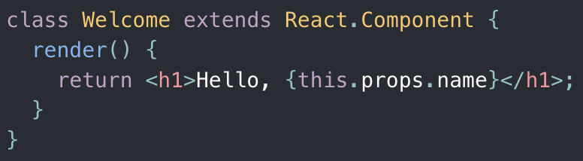
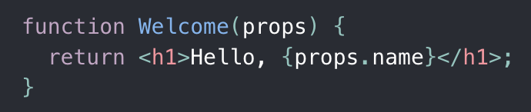
React: Components + Props
“React Only Updates What’s Necessary”
Function vs Class components
You can nest components (intuitive)
STRICT Rule: “All React components must act like pure functions with respect to their props” (this does not apply to State)
Notes:
React renders with the DOM (Document Object Model)
When a component’s state changes, React ONLY reloads that one component (saves time and computation).
Practically, react sees function/class components as the same. Choose whatever works for you.
NOTE: The Functional approach takes advantage of newer syntax and features such as React Hooks. I would personally choose that route, but both are totally fine.
Same props = same rendered component
No side effects, and props are read only.

Slide 7
React: Components + State
Component State = saved (and usually important) information about a component
Changing state -> trigger a component reload
Do not modify state directly (will not trigger reload). Use React’s state funcs.

Slide 8
React: Data (States & Props) Flow
Parent-Child relationships (think Tree)
State is always local, but can flow downwards (to children) as props.
Common Workaround: pass a state-modifying function as prop to child.
Child can then call the passed function to indirectly modify parent state.
Summary: State flows down (waterfall). Changes can sometimes flow back up.
(We will learn about state management libraries later on)
Notes:
React is based on parent-child relationships, like a tree data structure.
Neither parent nor child components know directly if a component is stateful or stateless.
Neither should care whether it is functional/class based.
State is always encapsulated in a component.
Pass state down to children as props

Slide 9
React: Design Process
How to think + code like a React dev:
Break UI into component list/hierarchy (form the Tree)
Build static version of UI first
Compatible with data models, but no interactions
Find simplest representation of UI state for each component
Identify where state should live
Add inverse data flow (changes go back up)
Notes:
Think about what components you need, how to organize your code structure, and how data flows in your app
First focus on getting all the components done. Don’t worry about interactions yet.
Make sure they all conform to your data models (which you should think about as well)
Try to identify the smallest set of mutable state each component needs. DRY: Don’t Repeat Yourself
Anything you can easily compute on the fly shouldn’t be in the state.
Eg. list of products, search text, checkbox status, filtered list of products
Is it passed from parents as props? (if so, not state)
Does it remain unchanged? (if so, not state)
Can you compute it based on other state/props? (if so, not state)
Final state: search text, checkbox status

Slide 10
Component Libraries/Frameworks
SUPER USEFUL (and fun to explore)
You no longer have to style everything by hand (b/c CSS bad).
Find one that you enjoy and read the docs on how to use it!
Popular ones:
MaterialUI (google)
Bootstrap
Ant Design (Ant Financial, Alibaba)
Evergreen
We’re gonna use Geist UI (more obscure, to get used to learning weird things)

